Slide 1
Mqtt CLIENT library for android
An overview of how to implement an MQTT client in Android and connect to a Broker
Abhilash K
DREAM:Lab, CDS, IISC

Slide 2
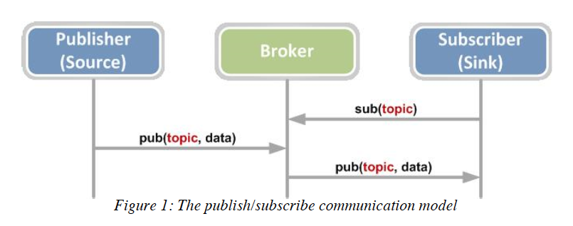
MQTT Protocol Overview

Slide 3
MQTT client libraries for Android
IISC Android Client
Eclipse Paho Android Client
HiveMQ Android Client
Among others

Slide 4
Advantages of IISC Android Client Library
Single Mqtt Service for multiple apps which need to use MQTT. It avoids redundancies if two client apps want to subscribe to same topic.
Saves Bandwidth by reusing same MQTT connection for multiple apps. For each MQTT connection that we maintain, a TCP port needs to be kept open always which keeps listening for subscribed topics. Lesser the number of ports less is the bandwidth used.

Slide 5
Advantages of IISC Android Client Library
Each client app does not need to run its own MQTT service thereby making them lighter.
The client apps do not have to handle MQTT details such as disconnection and reconnection issues / keeping the connection alive.
Configurable MQTT service parameters, better debugging and stats viewing via the Master app.

Slide 6
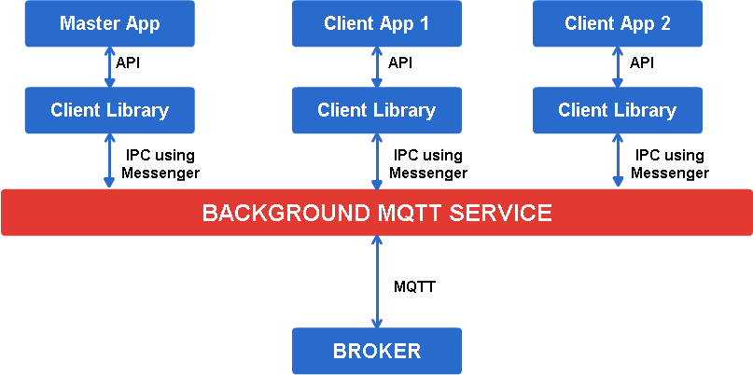
Superficial architecture of IISC client library

Slide 7
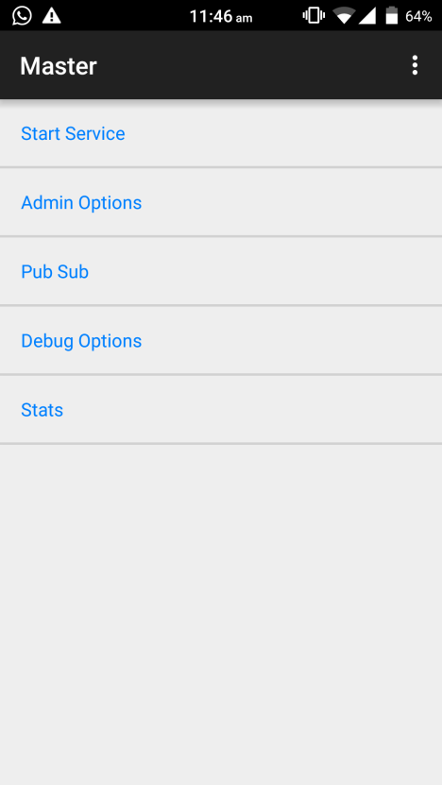
Using the IISC Client Library – STEP 1
Install the MQTT Master app
- Provides the services of an MQTT client
Configure the Master to connect to the broker
Use the associated API to access functionality of this service
Download the Master app from the Github repo: github.com/dream-lab/iot-school/android

Slide 8
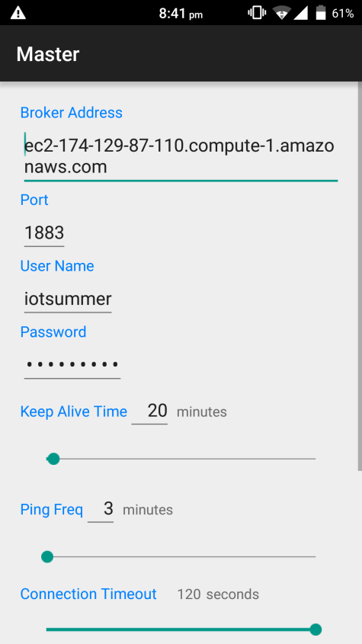
Using the IISC Client Library – STEP 2
Specify the broker config details and establish a connection
Use the default settings for connecting to the broker if you don’t have a broker instance, to connect to the broker setup by IISC
Use “Debug Options” to have a quick check about the state of the connection

Slide 9
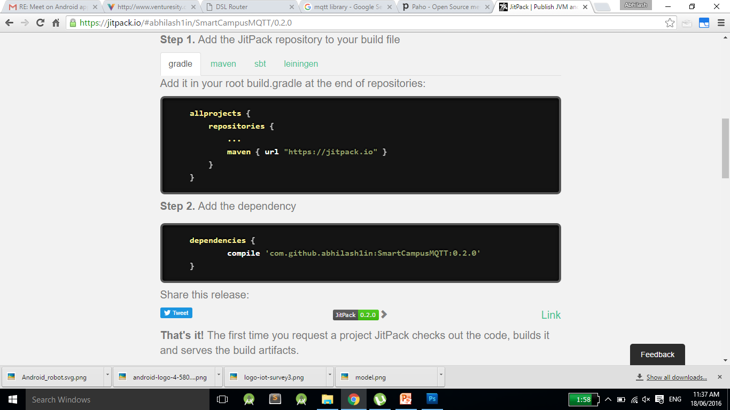
Using the IISC Client Library – STEP 3
Get the client API library to interact with the service:

Slide 10
Client Library API
SCServiceConnector (ServiceStatusCallback)
ServiceStatusCallback Returns a callback once we connect to or disconnect from the Mqtt background service
ServiceAdapter(Context)
public void startAndBindToService(SCServiceConnector)
- This API is used to attach the client app to the mqtt service.
public void unbindFromService(SCServiceConnector)
- This API is to disconnect the client app from the service.

Slide 11
Client Library API
ServiceAdapter(Context) (contd)
public void publishGlobal(String topicName, String eventName, String dataString,Messenger replyMessenger)
-This API is used to publish messages to the broker
topicName - The topic on which the data is to be published.
eventName(Optional) - Name of the event on which the data is to be published (null if not used)
dataString - the actual data to be published (JSON/SenML)
replyMessenger - Messenger instance on which the callback for the publish status will be received.
Example
topic name - iisc/smartx/water/waterlevelsensor
eventName - Water Level (or null)
dataString - GPS coordinates of the water leakage in JSON/SenML

Slide 12
Client Library API
ServiceAdapter(Context) (contd)
public String subscribeToTopic(String topicName,Messenger replyMessenger)
-This API is used to subscribe to a topic.
topicName - the topic to be subscribed to
replyMessenger - Messenger instance on which the callback for the subscription status will be received.
public void unsubscribeFromTopic(String topicName,Messenger replyMessenger)
- Similar to subscribe but used for unsubscribing from a topic
public void checkMqttConnection (Messenger replyMessenger)
- This API is used to check if the background Mqtt service is connected to the broker. Return a reply in the form of an enum (connected/Notconnected/ Connection in progress ) using the replyMessenger.

Slide 13
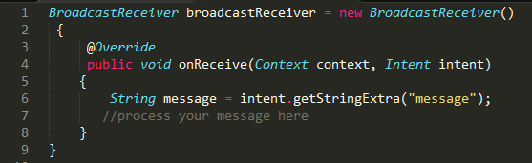
Client Library API
Receive messages through:
BroadcastReceiver
- Setup a BroadcastReceiver in your receiving service / activity

Slide 14
Use cases
Publish to a topic concerned with the sensor/device data
Say, for a temperature sensor, publish the dataString as
{
"message":
[
{ "device_id1": {"temperature": “25", "unit": “C” } },
{"device_id2": {"temperature": “77", "unit": “F” } }
]
}
Note: use SenML format
Subscribe to this control topic on the Android Device to monitor the temperature and process as per your need

Slide 15
Chat Application Demo
Download the MQTT Chat app from the GitHub repo
Setup the Master App and connect to broker
Click on Reset to use the default settings
Setup Chat App
Settings >
Username : [choose a username]
Topic : iisc/summerschool/iot/chat

Slide 16
Contribute
IISC MQTT Client Library – Alpha Stage
https://github.com/abhilash1in/SmartCampusMQTT
Code Sample – Chat Application
https://github.com/dream-lab/iot-school
Code Sample – Water Monitoring https://github.com/shshnk28/SmartWaterClientApplication

Slide 17

{ Development In Progress }
Report any issues on the GitHub repo
https://github.com/dream-lab/iot-school/issues

Slide 18
Thank You! github.com/dream-lab/iot-school

